Slide 1

Frequency Division Multiplexing
Submit by
SOUVIK GHOSH
Roll No. :- 16800117016
Dep. :- CSE
Year :- 3rd

Slide 2
What is Multiplexing ?
Multiplexing is the set of techniques that allows the simultanous transmission of multiple signals acoross a single data link .
The multiplexed signal is transmitted over a communication channel such as a cable. The multiplexing divides the capacity of the communication channel into several logical channels, one for each message signal or data stream to be transferred. A reverse process, known as demultiplexing, extracts the original channels on the receiver end .
A device that performs the multiplexing is called a multiplexer (MUX), and a device that performs the reverse process is called a demultiplexer (DEMUX or DMX).
The process of combining the data streams is known as multiplexing and hardware used for multiplexing is known as a multiplexer.
For example, in telecommunications, several telephone calls may be carried using one wire. Multiplexing originated in telegraphy in the 1870s, and is now widely applied in communications. In telephony, George Owen Squier is credited with the development of telephone carrier multiplexing in 1910.

Slide 3
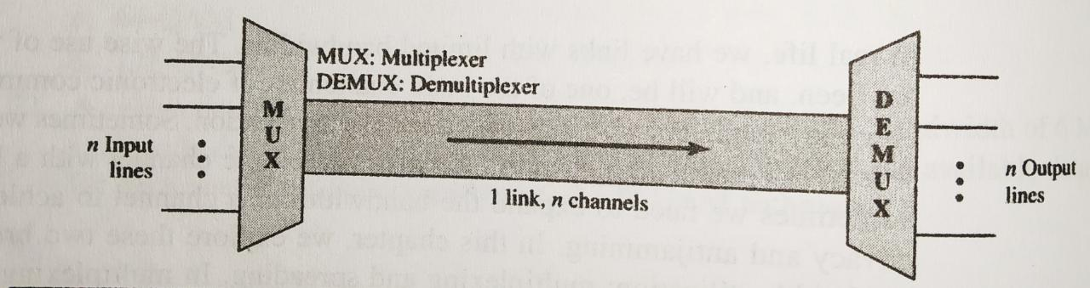
Basic Format of a Multiplexed System
In the fig. The word link refers to the physical path . The word channel refers to the portion of a link that carries a transmission between a given pair of line .
One link can have many(n) channels .

Slide 4
Type of multiplexing
Multiplexing
Analog
Digital
Time-Division
Multiplexing
(TDM)
Frequency-Division
Mulltiplexing
(FDM)
Wavelength-Division
Multiplexing
(WDM)

Slide 5
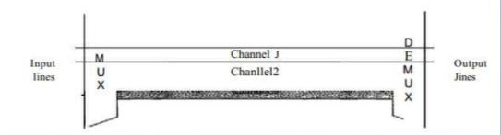
What is Frequency Division Multiplexing ?
Frequency-Division Multiplexing (FDM) is a signal transmission technology in which multiple signals can simultaneously be transmitted over the same line or channel . It is a analog technique . It can be used in both wired and wireless networking for transmitting large amounts of data at high speeds. FDM is the simplest and oldest form of multiplexing in wireless networking technology.
Figure below gives a conceptual view of FDM. In this illustration, the transmission path is divided into three parts, each representing a channel that carries one transmission.

Slide 6
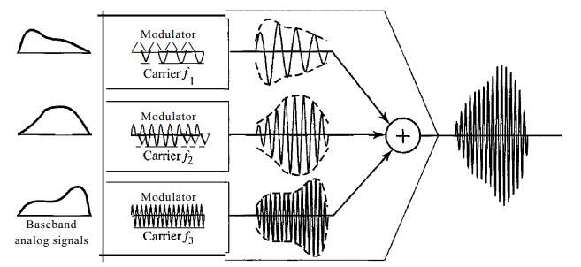
Multiplexing Process

Slide 7
Multiplexing Process
Each source generates a signal of a similar frequency range.
Inside the multiplexer, these similar signals modulates different carrier frequencies ( f 1 , f 2 , f 3 ).
The resulting modulated signals are then summed into a single composite signal and is sent out over a media link that has enough bandwidth to accommodate it.
The composite signal transmitted across the medium is analog
The input signals may be either digital or analog.
A digital signal must be passed through a modem

Slide 8
Demultiplexing Process

Slide 9
Demultiplexing Process
At the receiving end, the composite signal is passed through bandpass filters, each filter decompose the multiplexed signal into its constituent component signals .
Individual signals are then passed to a demodulator that separates them from their carriers and passes them to the output lines .

Slide 10
Advantages of FDM
A large number of signals can be transmitted simultaneously .
FDM does not need synchronization between its transmitter and receiver for proper operation .
Demodulation of FDM is easy.
Due to slow narrow band fading only a single channel gets affected.

Slide 11
Disadvantages of FDM
The communication channel must have a very large bandwidth .
Intermodulation distortion takes place .
Large number of modulators and filters are required .
FDM suffers from the problem of crosstalk .
All the FDM channels get affected due to wideband fading .

Slide 12
Applications
Used majorly in radio and television broadcasting.
FDM can be implemented very easily. In many cases, such as radio and television broadcasting, there is no need for a physical multiplexer or demultiplexer. As long as the stations agree to send their broadcasts to the air using different carrier frequencies, multiplexing is achieved. In other cases, such as the cellular telephone system, a base station needs to assign a carrier frequency to the telephone user.
Thank You

